Slide 1

Treasurer’s Report
Presented by Michael W. Davis, Treasurer
St. Columba’s Episcopal Church
November 10, 2024

Slide 2
Members of the Finance Committee
Jim Barnett
Hal Davis
Mike Davis
Peter Dean
Sara Glenn
Ledlie Laughlin
Sam LeBlanc
Gina Lagomarsino
Ann Lung
Jane Ward
Torie Proctor, Director of Finance and Administration
Notes:
Before I begin, I want to thank the members of the Finance Committee for their hard work this past year. Without them, what I am about to share would not have been possible.
I also want to thank Greg Parker, who was our Finance Director for FY 2024; as many of you know, he is a member of our church and would have joined us this morning but he is currently in the music room preparing for the 11 a.m. service.
And last, but not least, I want to introduce and welcome Torie Proctor, our new Director of Finance and Administration. Torie joined us at the end of FY 2024.

Slide 3
AGENDA
2024 Key Audit Takeaways
2024 Results (Church & Nursery School)
2025 Budget
Stewardship Update

Slide 4
Key Takeaways FY 2024 Audit (Church and Nursery School)
The Fiscal Year (FY) ending June 30, 2024 audit (Audit) was conducted by Wegner CPAs (Auditors), a national firm that has extensive experience with religious organizations.
The Auditors gave our financial statements a clean (Unmodified) opinion.
The audit was completed on time and approved by the Finance Committee and the Vestry in October.
The Church and Nursery School had a combined increase in assets or surplus of $995,393.
Notes:
One material weakness identified but no significant deficiencies in internal controls over financial reporting.

Slide 5
2024 Audit Highlights (Church and Nursery School)
 | 2023 |  | 2024
Assets
Cash and Investments | $ 4,916,270 |  | $ 5,454,463
Contribution receivable, net | $ 2,678,452 |  | $ 2,035,988
Property and equipment, net | $ 8,701,369 |  | $ 8,639,036
ERC receivable | $ - |  | $ 552,676
Other Assets | $ 60,363 |  | $ 96,610
Total Assets | $ 16,356,454 |  | $ 16,778,773
Liabilities and Net Assets
Accounts payable and other | $ 1,418,185 |  | $ 1,488,106
Notes payable | $ 2,010,012 |  | $ 1,367,017
Total Liabilities | $ 3,428,197 |  | $ 2,855,123
Net Assets | $ 12,928,257 |  | $ 13,923,650
Total liabilities and Net assets | $ 16,356,454 |  | $ 16,778,773
Notes:
The Church and the Nursery School are one legal entity, so our audit is on a consolidated basis.
Growth in the current assets from the prior year due to the net income, better investment performance, and the Employee Retention Credit.
Contribution receivable breakdown at year-end (not sure these numbers are right but in the ball park)
2024 Pledges were $1,166,875
Leap of Faith was $342,171
Nave Repair Capital Campaign was $597,015
Notes payable decreased by $642,995 principally because we continue to make principal payments on the loan taken out for the Nave Project. Our notes payable are about $1.4 million and consist of a. mortgage with a balance of about $100k on a house the church owns, and the remaining balance on a house the church owns and the note for the nave project secured by our building.

Slide 6
2024 Audit Highlights (Church and Nursery School)
 | 2023 |  | 2024
Revenue
Contributions | $ 4,012,107 |  | $ 3,480,021*
Tuition and fees, net | $ 2,157,174 |  | $ 2,345,226
Program and Event income | $ 150,587 |  | $ 445,833
Investment income, net | $ 180,608 |  | $ 307,355
Employee Retention Credit (ERC) | $ - |  | $ 552,676
Other income | $ 6,588 |  | $ 368,902
Total Revenue | $ 6,507,064 |  | $ 7,500,013
* $352,941 donor restricted contributions
Notes:
Contributions decreased by $532,086 but this is principally due to the fact that for FY 2023, Ledlie raised funds for the Leap of Faith Campaign ($868k to be paid over three years, plus the nursery schools $50k contribution that year – only used @50k for operations, the rest has been used to help fund Capital Campaign,
Nursery school tuition and fees increased by $188,052. The NS is principally responsible for increase in Other income due to the receipt of a grant from the DC government, which ultimately flows through to the teachers.
Program income increased, and investments performed better in FY24 by $126,747 indicating higher returns on investments resulting in an overall increase.
Next Page: Expenses also increased from the prior year.

Slide 7
2024 Audit Highlights (Church and Nursery School)
 | 2023 |  | 2024
Expenses
Program services
Church | $ 3,199,189 |  | $ 3,386,665
Nursery school | $ 1,970,843 |  | $ 2,312,597
Total Program Services | $ 5,170,032 |  | $ 5,699,262
Management and general | $ 628,520 |  | $ 685,514
Fundraising | $ 47,688 |  | $ 119,844
 | $ 676,208 |  | $ 805,358
Total Expenses | $ 5,846,240 |  | $ 6,504,620
Net Assets Released from Restriction | $ 143,806 |  | $ 112,822
Notes:
Expenses also increased from the prior year.
Total Expenses increased from $5,846,240 in 2023 to $6,504,620 in 2024, reflecting an overall rise in spending.
Program Services:
Church:
2023: $3,199,189 2024: $3,386,665
Increase of $187,476, showing higher operational or service costs for church programs.
Nursery School:
2023: $1,970,843 2024: $2,312,597
Increase of $341,754, indicating increased investment in nursery school operations.
Total Program Services rose from $5,170,032 in 2023 to $5,699,262 in 2024, a net increase of $529,230.
·
Management and General Expenses:
2023: $628,520 2024: $685,514
Increase of $56,994, indicating higher general administrative costs.
Fundraising Expenses:
2023: $47,688 2024: $119,844
Increase of $72,156, suggesting increased focus or spending on fundraising efforts.
·
Total Expenses:
2023: $5,846,240 2024: $6,504,620
Overall, there was a net increase of $658,380 in total expenses.
Net Assets Released from Restriction:
2023: $143,806 2024: $112,822
Decrease of $30,984, meaning fewer restricted funds were used to cover expenses in 2024 compared to 2023.

Slide 8
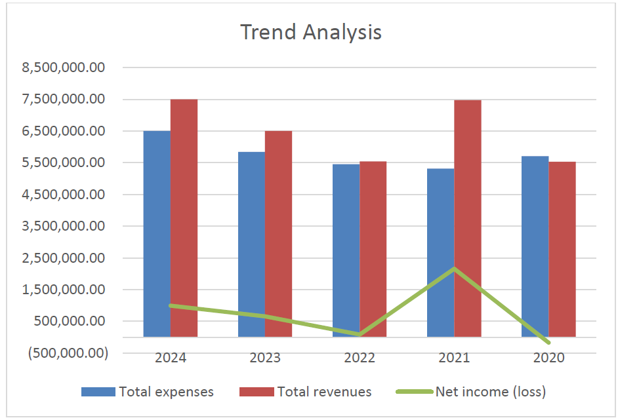
2024 Audit Highlights- Trend and Revenue Analysis (Church and Nursery School)

Slide 9
2024 Audit Highlights (Church and Nursery School)
Total Change in net assets (surplus) $ 995,393.00
The change in net assets includes the Employee Retention Credit (ERC) and a grant the Nursery School received through the District of Columbia Preschool Grant program, for which our nursery school qualified. These funds have contributed significantly to the financial support of our operations, aligning with our goal of enhancing educational services and maintaining staff during challenging times.
Notes:
For fiscal year 2024, all activities of the combined Church and Nursery School resulted in a total change in net assets, or surplus, of $995,393. The Church contributed $238,575, while the Nursery School contributed $756,818.
The ERC is a refundable tax credit for certain eligible businesses and tax-exempt organizations that had employees and were affected during the COVID-19 pandemic. The IRS was concerned about a large number of improper ERC claims and is closely reviewing tax returns that claim the credit. Applies to 2020 and first three quarters of 2021. Qualify if (1) operations were suspended by a government order due to the pandemic or experience the required decline in gross receipts for that period.

Slide 10

Liquid Unrestricted Net Assets (LUNA)
Debt to Equity Ratio
Notes:
I won’t spend much time of this, but for those of you who are interested in financial metrics, two key financial metrics: Liquid Unrestricted Net Assets (LUNA) and the debt-to-equity ratio. It highlights that the debt-to-equity ratio has remained stable compared to the previous year and has shown improvement over the past five years. Additionally, LUNA has increased, with the reserves now able to theoretically support nearly a full year of operations

Slide 11
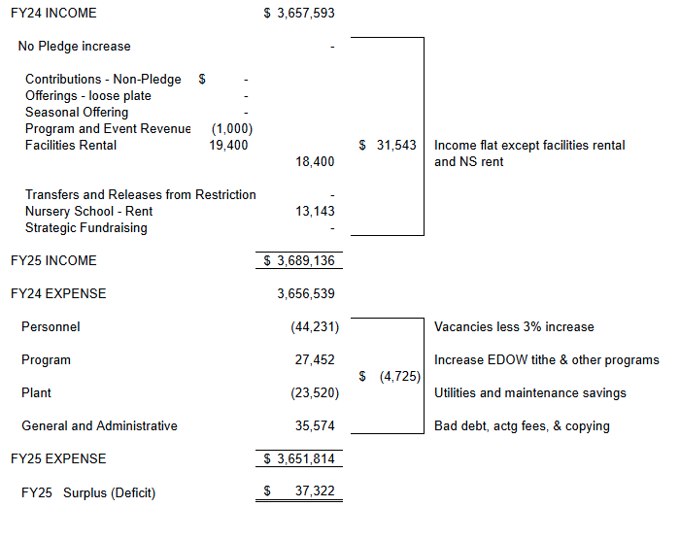
Comparison of FY 2024 to FY 2025 Budget
Notes:
We don’t have time to go through the 2025 budget in detail. But at a high level, aware of the Capital Campaign – the Finance Committee, Vestry and staff worked very hard to produce a budget that did not rely on an increase in stewardship pledges for FY 25 to balance the budget.
Walk through increases.
This page shows the total income and expense of the 2024 budget and the increases or decreases made to arrive at the 2025 budget.
The budget increased by about $31,543.00.
Expenses decreased because of vacancies less 3% increase , about $50,000 in program, and also utilities and maintenance.
Revenue increased because of the 5% pledge increase, utilities and maintenance savings, increase in EDOW tithe and other programs.
The 2025 budget will hopefully breakeven with a budgeted surplus of $37,332.
Mention Vestry’s commitment to the endowment – for first time in many years, all funds bequeathed to the church went into the endowment and stayed there.

Slide 12
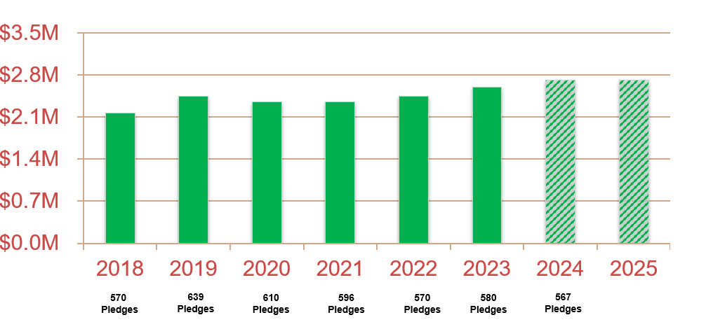
Stewardship Pledge Trends
Percentage of Revenue provided by pledges 76%
Notes:
This shows how much we have raised from the annual pledge drive and the number of families contributing.
Although the number of pledges has dropped, the amount raised has increased every year since 2020.
We are grateful that our parishioners support has grown during difficult times.
Our 2024 & 2025 goal is $2,741,036. To date, we have received 280 pledges that total $1.625 million, or about 59% of goal.
Last year pledges made up close to 79% of our revenue – so that is good.
BUT WE STILL NEED YOU TO INCREASE YOUR PLEDGE IF YOU CAN? WHY? BECAUSE OUR BUDGET ONLY GOES THROUGH JUNE OF 2025. ANY INCREASES WILL HELP US AS WE PREPARE FOR THE FY 2026 BUDGET SOON WHICH WILL BEGIN ON JULY 1 OF NEXT YEAR.

Slide 13
Thank You!
If you have pledged, thank you!
If you haven’t pledged, please do!
If you can increase your pledge, please do!
Thank you for your support!
Notes:
If you have questions that you weren’t able to ask in the time we had this morning, please feel free to contact Torie or me.
We hope this report has demonstrated that our finances are sound and the path forward is promising even with challenges. We also hope it helps everyone understand how important pledging is to the financial health of St. Columba’s.
If you have pledged, thank you!
If you haven’t pledged, please do!
If you can increase your pledge, please do!
Thank you all for the many ways you support St. Columba’s!

Slide 14


